Slide 1
KAT uPVC Doors and Windows
SKIP TO:
Elegance Box Sash
Mayfair Box Sash
Sliding Patio Doors
Bifolding Doors
Flush Casement Windows

Slide 2
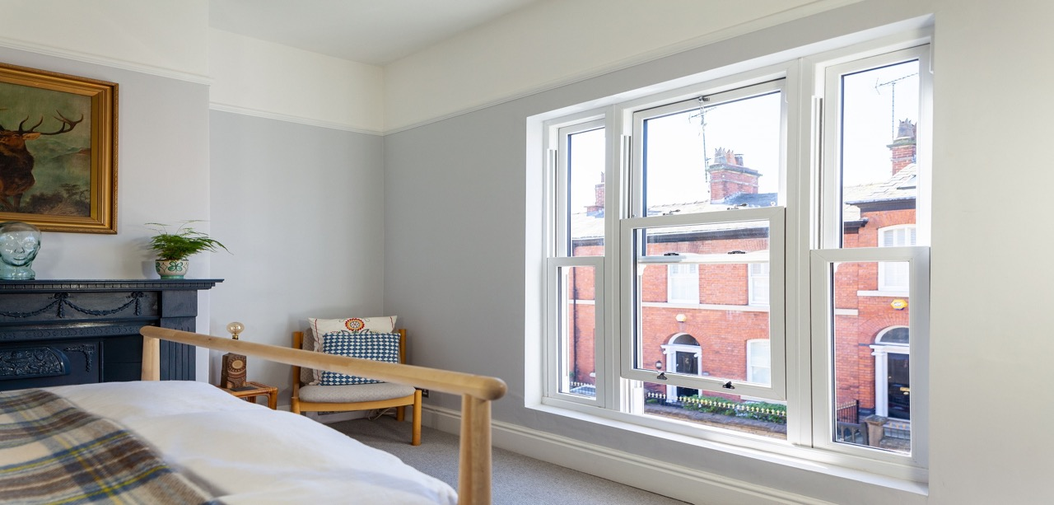
Elegance Vertical Sliding Sash Windows

Slide 3
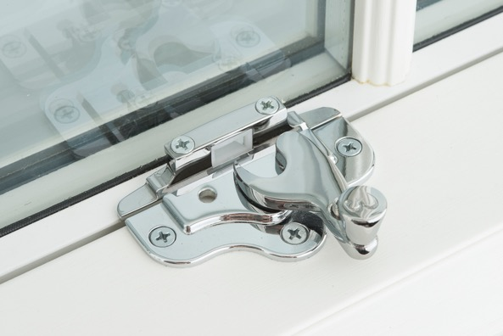
Elegance Vertical Sliding Sash Windows
Features
Halo profile
Unique beautifully styled Cam Catch
Suited tilt latch knobs
Fully featured ovolo detail
133mm / 146mm deep frame options
Up to 1600mm x 3000mm
U-Value 1.4

Slide 4
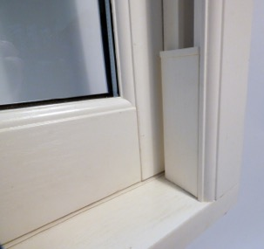
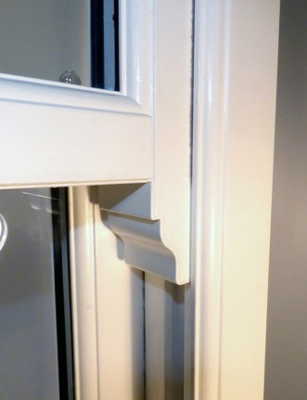
Elegance Vertical Sliding Sash Windows
Optional
Deep bottom rail
Run through horn
Slim meeting rail
Unique and Authentic Georgian bar
PAS24
Fire escape egress hinges
Child restrictors
Stub Cill 85mm, 120mm, 160mm, 200mm

Slide 5
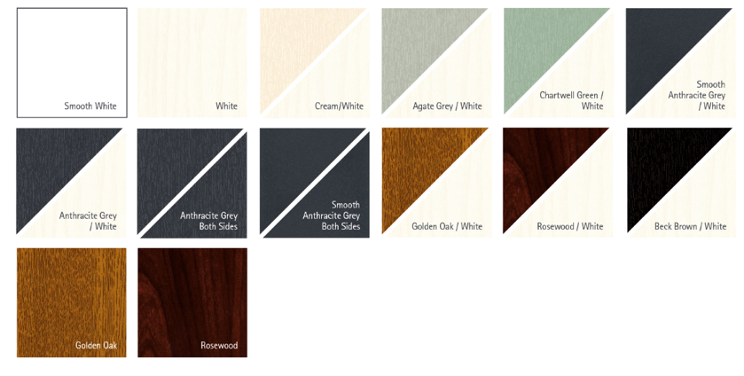
Elegance Vertical Sliding Sash Windows
Standard Colours

Slide 6
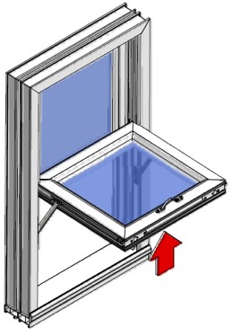
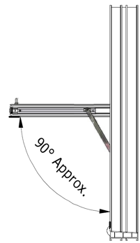
Elegance Vertical Sliding Sash Windows
Fire Egress option
Minimum width - 872mm
Minimum height – 1080mm
Inside
Outside

Slide 7
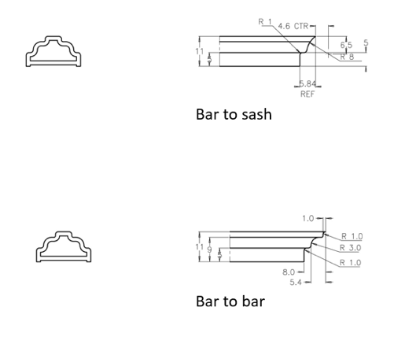
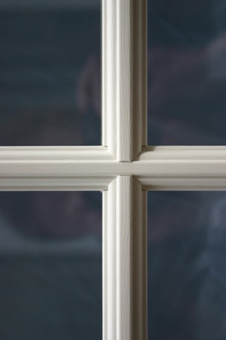
Elegance Vertical Sliding Sash Windows
Georgian Bar Detail

Slide 8
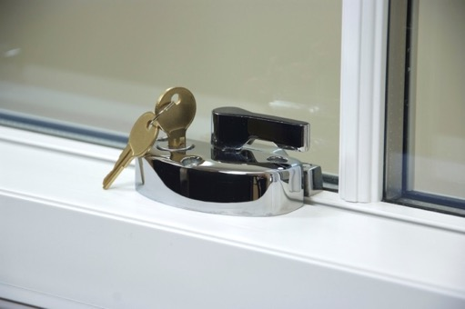
Elegance Vertical Sliding Sash Windows
Enhanced Security PAS24 Option
Capable of achieving PAS24 to comply with Document Q
Additional features to comply are:
Cam catches and Keeps
Tilt latches
Security block to top sash
Jamb packers to frame
Sash spacers
Changes to reinforcing specification

Slide 9
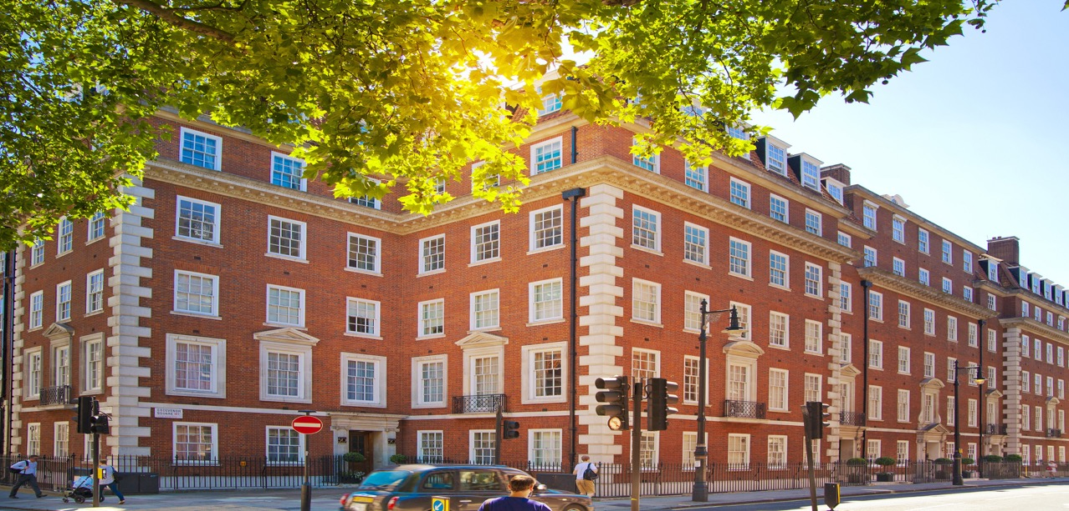
Mayfair Vertical Sliding Sash Windows

Slide 10
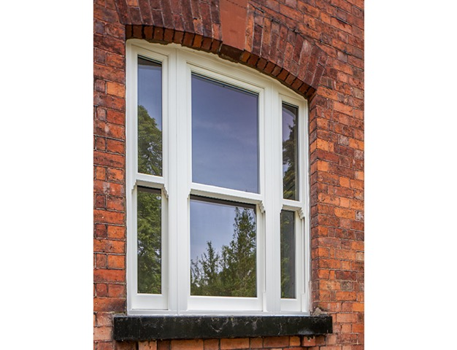
Mayfair Vertical Sliding Sash Windows
Features
Fully mechanically jointed
133mm or 146mm front to back frame depth
Flush frame and flush integral cill features
Ideal for conservation areas
Max size w: 1600mm x 3000mm

Slide 11
Mayfair Vertical Sliding Sash Windows
Options:
PAS 24 Security – alternative cam catches will be fitted

Slide 12
Mayfair Vertical Sliding Sash Windows
Colour options:
White ash grained both sides as standard
Special foil options considered

Slide 13
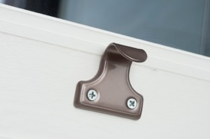
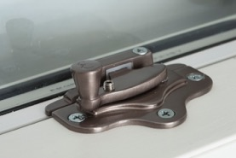
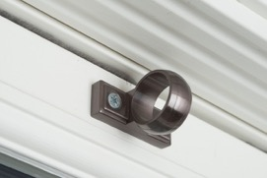
Mayfair Vertical Sliding Sash Windows
Hardware
KAT suited sash lifts, ‘hook and claw’ cam locks and ring pulls in:
White
Antique Gold
Chrome
Satin
Pewter

Slide 14
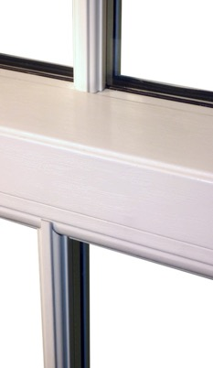
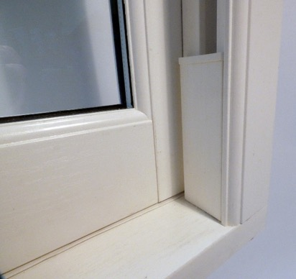
Mayfair Vertical Sliding Sash Windows
Hand crafted:
Run through horn
Deep bottom rail
Slim meeting rail
Unique Georgian Bar

Slide 15
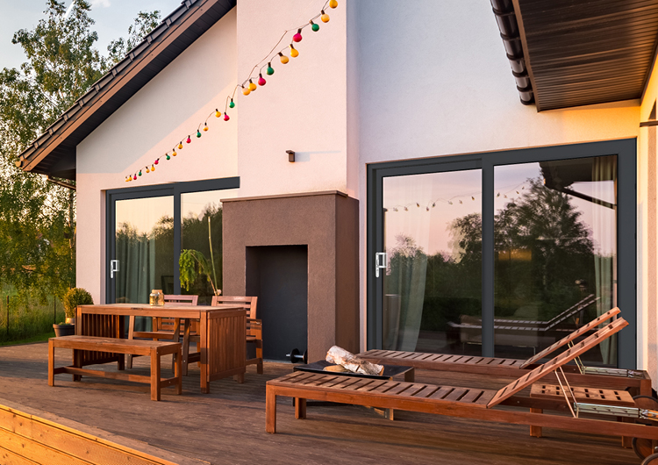
Elegance uPVC Sliding Patio Doors

Slide 16
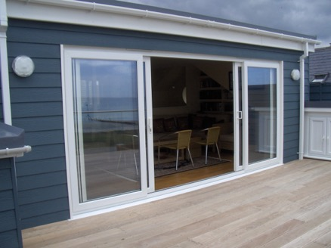
Elegance uPVC Sliding Patio Doors
Features
2, 3 or 4 pane options
6 hook bi-directional locking system
with 3 star security cylinder
Hercules Self- Levelling Rollers
Chamfered or Ovolo system
Sliding leaf internally as standard (externally if required)
Sits on 95/150/180 cills (except low threshold)

Slide 17
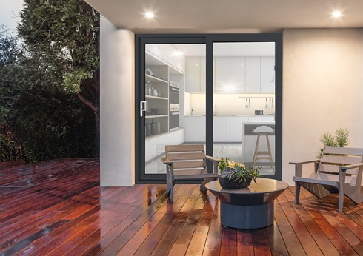
Elegance uPVC Sliding Patio Doors
Dimensions:
2 pane width – min 1600mm : max 3000mm
3 pane width – min 2400mm : max 4000mm
4 pane width – min 3000mm : max 5000mm
Height – min 1600mm : 2400mm (standard threshold)
Height – min 1600mm : 2365mm (low threshold)

Slide 18
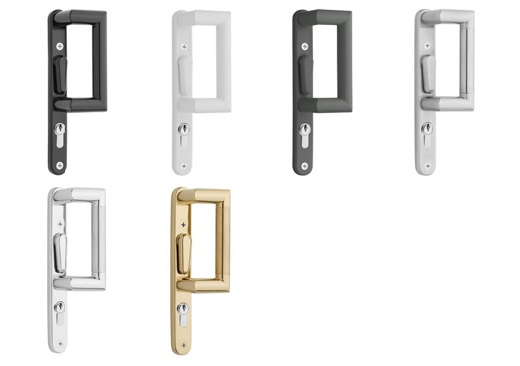
Elegance uPVC Sliding Patio Doors
Hardware
Vanguard handles, bespoke to KAT
In Black, White, Grey, Satin, Chrome
or Gold
10 year guarantee

Slide 19
Elegance uPVC Sliding Patio Doors
Standard Colours

Slide 20
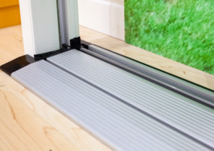
Elegance uPVC Sliding Patio Doors
58mm fully weathered threshold as standard
20mm low threshold:
Part M compliant
Cannot be used with a cill
Ramp is an optional extra
15mm Room divider suitable for internal use

Slide 21
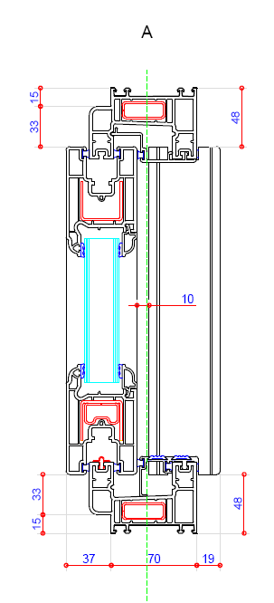
Elegance uPVC Sliding Patio Doors
Options:
PAS24 upgrade (internal slider only)
Meeting style security bolts
Shootbolts - 8 hook lock on tall doors (2 or 3 pane only)
Welded or Kit form outerframe

Slide 22
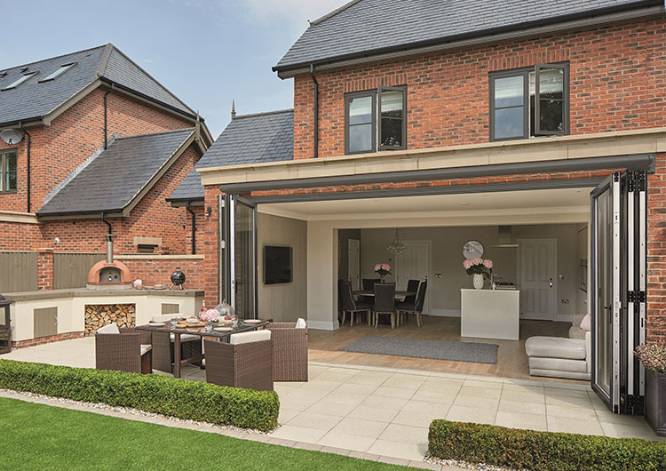
Imagine uPVC Bifold Doors

Slide 23
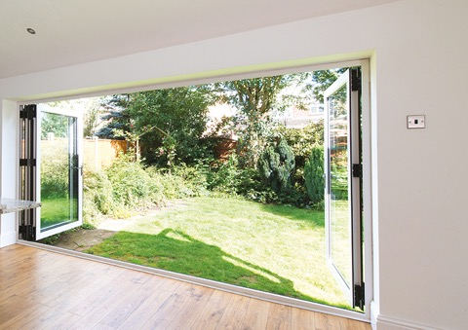
Imagine uPVC Bifold Doors
From 2 to 7 panels in various configurations
Inward or outward opening
Multipoint locking system to master door
3 star diamond security cylinder lock with Kitemark
D Handle to intermediate doors
Chamfered or Ovolo beads
Maximum sash width 1000mm
Maximum door height 2213mm
28mm glazing
Sits on 85/150/180 cills (except low threshold)

Slide 24
Imagine uPVC Bifold Doors
Standard Colours

Slide 25
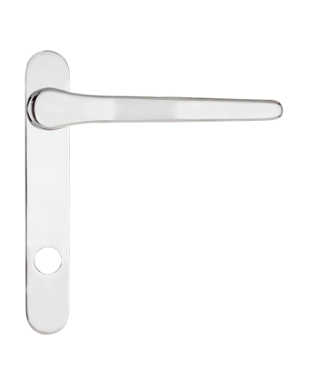
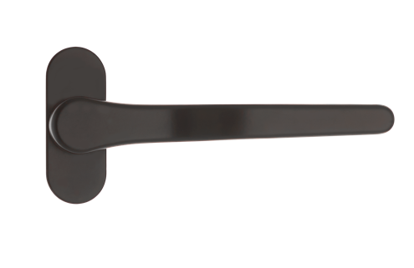
Imagine uPVC Bifold Doors
Hardware
Cranked master handles available in White, Black, Gold or Chrome
Cranked intermediate handles available in White, Black, Gold or Chrome
D Handle in Black or White

Slide 26
Imagine uPVC Bifold Doors
Threshold Options
65mm fully weathered threshold as standard
30mm fully weathered low threshold
Mobility ramps are available
15mm room divider (not weathered)
30mm Low threshold with 2 ramps
30mm Low threshold with 1 ramp

Slide 27
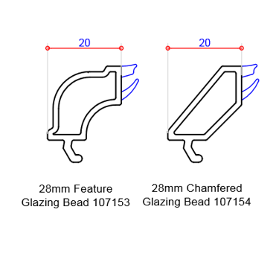
Imagine uPVC Bifold Doors
Glazing Beads
28mm Glazing Bead
Ovolo or Chamfered

Slide 28
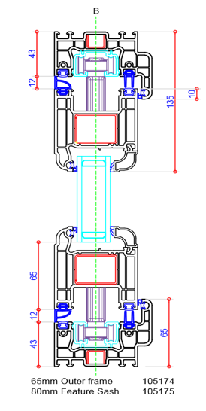
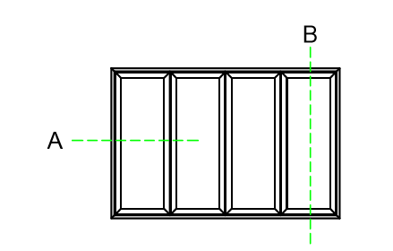
Imagine uPVC Bifold Doors
Section-through Drawings

Slide 29
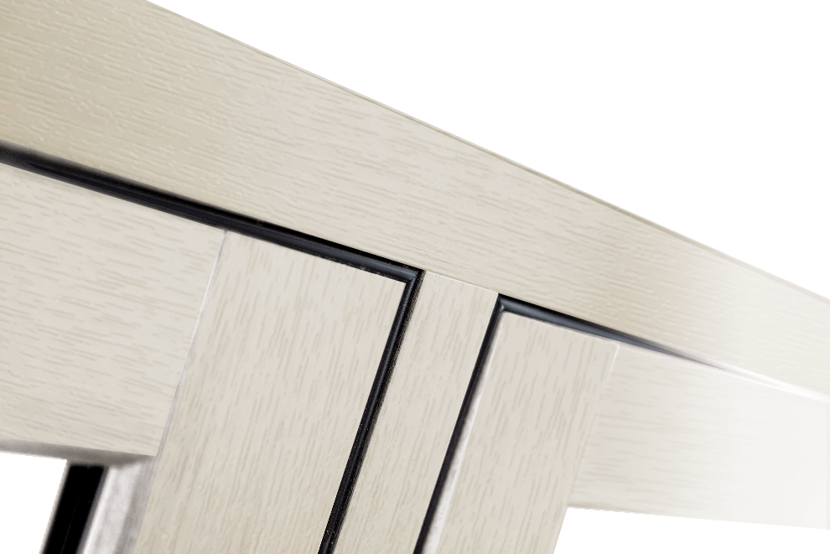
Knightsbridge uPVC Flush Casement Windows

Slide 30
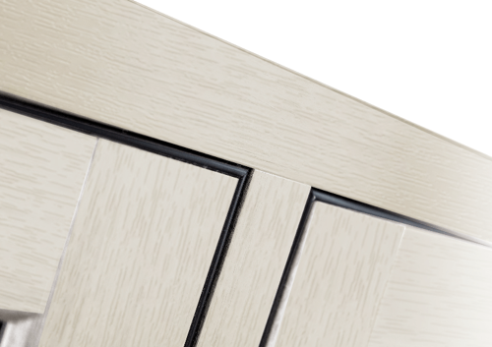
Knightsbridge uPVC Flush Casement Windows
Features
Fully mechanically jointed
Authentic alternative to timber
U-Value 1.4 W/m2K
Georgian bars available
Dummy sashes to non-openers
Optional
Floating mullion – no option for dummy sashes

Slide 31
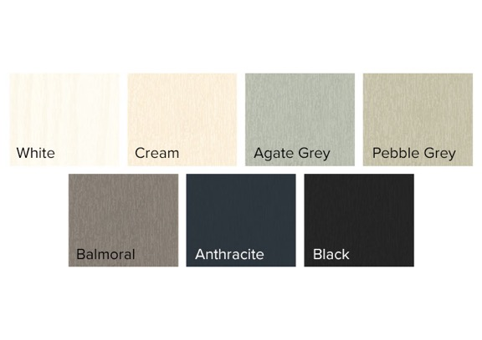
Knightsbridge uPVC Flush Casement Windows
Stock Colours
7 Woodgrain finishes externally
White Woodgrain finish internally
Optional:
Smooth White finish both sides

Slide 32
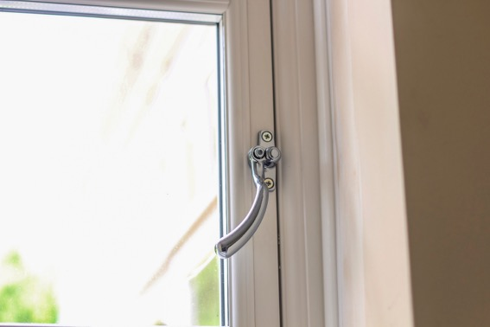
Knightsbridge uPVC Flush Casement Windows
Hardware
Push button locking handle in
White, Chrome, Gold, Black,
Antique Black or Graphite
Tear Drop and Monkey Tail handle
in Chrome, Antique Black, Graphite
or Gold

Slide 33
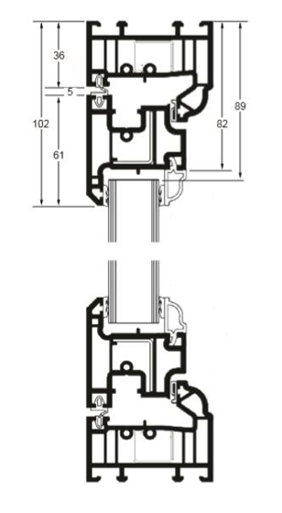
Knightsbridge uPVC Flush Casement Windows
Outerframe detail
Frame depth 70mm
Flush sash externally
Sculptured Ovolo finish internally
Maximum sizes
Side Hung 700mm x 1350mm
Top Hung 1250mm x 1250mm
Optional:
Chamfered finish internally

Slide 34
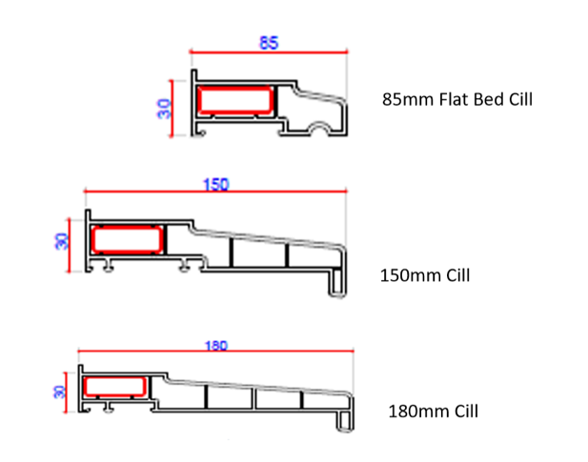
Knightsbridge uPVC Flush Casement Windows
Cills
85mm Flat Bed
150mm
180mm

Slide 35
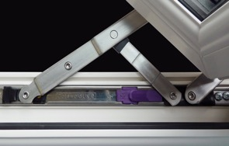
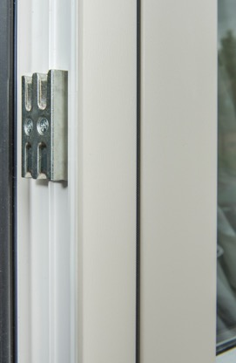
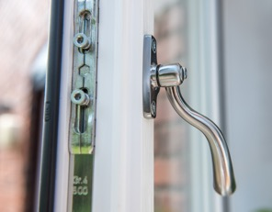
Knightsbridge uPVC Flush Casement Windows
Security
Multi-point locking securing all 4 sides
of opening sash
Fire escape/easy clean hinges fitted
to all side openers

Slide 36
KAT uPVC Doors and Windows
SKIP TO:
Elegance Box Sash
Mayfair Box Sash
Sliding Patio Doors
Bifolding Doors
Flush Casement Windows

