Slide 1
KAT Aluminium Doors and Windows
Skip To:
Windows
Sliding Doors
Bifolding Doors
Entrance Doors
Art Deco Doors and Windows

Slide 2
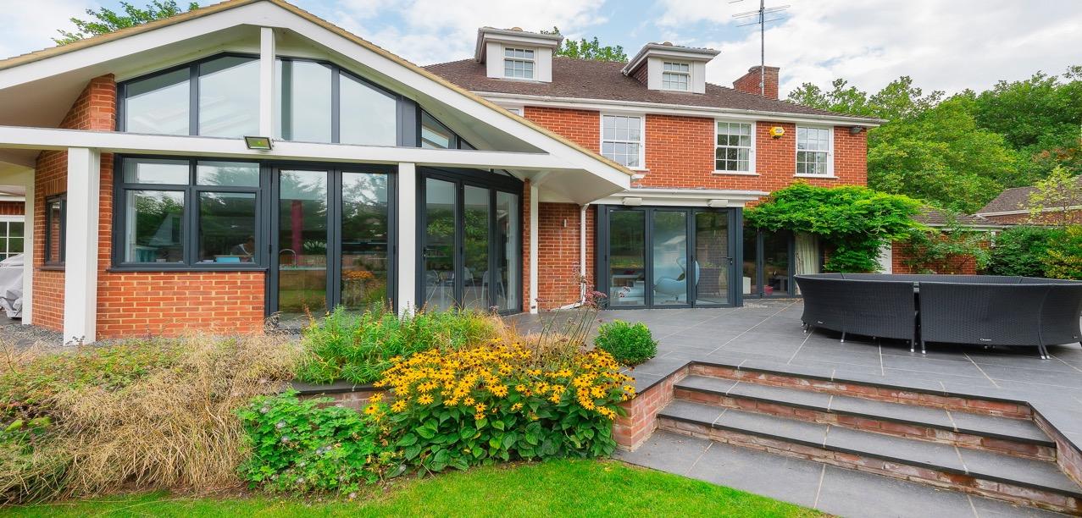
Aluminium Casement Windows

Slide 3
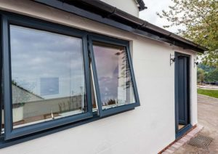
Aluminium Casement Windows
Features
72mm frame depth
Slim sight lines brick to glass – 88mm
Exclusive Hi-Reflex spacer bar thermal break technology
Maximum sizes:
Top hung 1600mm x 1750mm
Side hung 845mm x 1600mm
Window U-Value 1.4 with centre pane of 1.2
Externally beaded – square bead

Slide 4
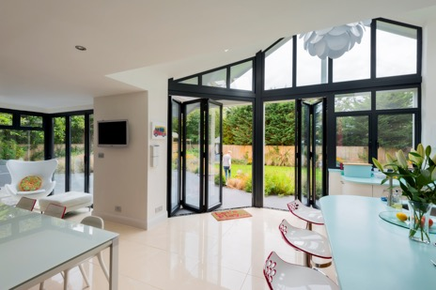
Aluminium Casement Windows
Options
Shaped fixed frames
Windows can be side hung, top hung or fixed
Corner posts and bay solutions
28mm and 36mm Chamfered bead
32mm Square bead
Windows can be internally beaded

Slide 5
Aluminium Casement Windows
Colours
Anthracite Grey in a luxurious Textura
finish from stock
A wide range of RAL colours in Textura, Matt
or Gloss finish are available

Slide 6
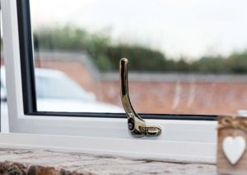
Aluminium Casement Windows
Hardware
Push button locking handles available in:
Black
White
Gold
Satin Chrome
Polished Chrome

Slide 7
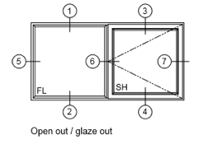
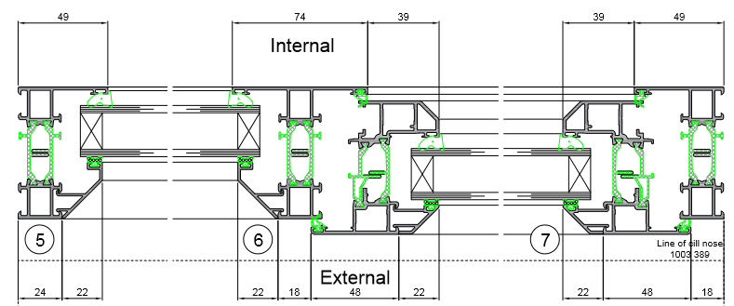
Aluminium Casement Windows
Section through drawings

Slide 8
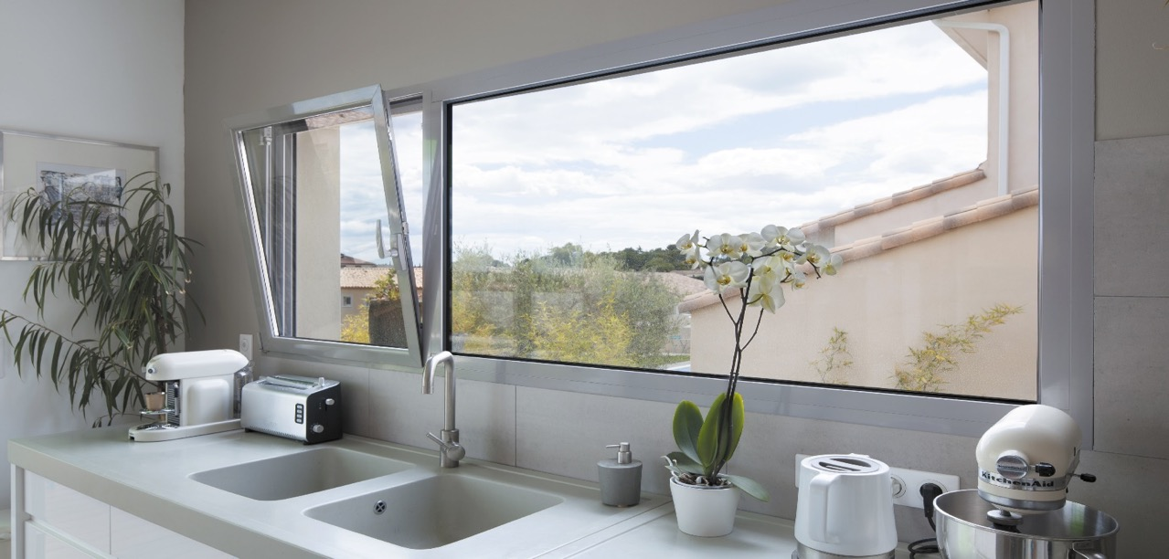
Aluminium Tilt Turn Windows

Slide 9
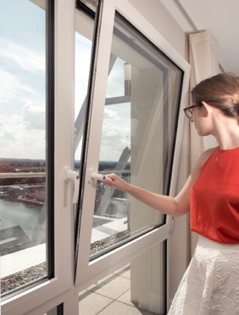
Aluminium Tilt Turn Windows
Features
72mm deep frame front to back
79mm Slim sight lines brick to glass across
frame and sash
Square bead – externally glazed
Maximum sash 1600mm x 2100mm
Full window U-Value 1.4 with centre pane of 1.2

Slide 10
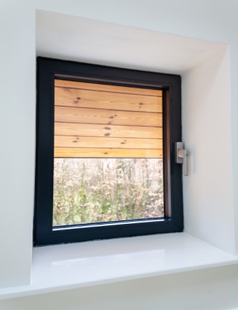
Aluminium Tilt Turn Windows
Options
Can meet PAS 24
Fixed post and variable bay solutions

Slide 11
Aluminium Tilt Turn Windows
Colours
Anthracite Grey in a luxurious Textura
finish from stock
A wide range of RAL colours in a Textura, Matt
or Gloss finish are available

Slide 12
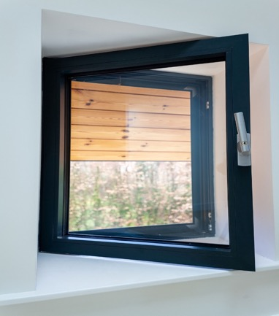
Aluminium Tilt Turn Windows
Hardware
Inox Silver
White

Slide 13
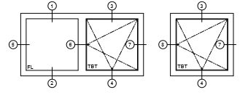
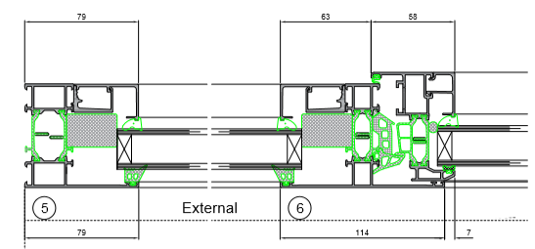
Aluminium Tilt Turn Windows
Section through drawings

Slide 14
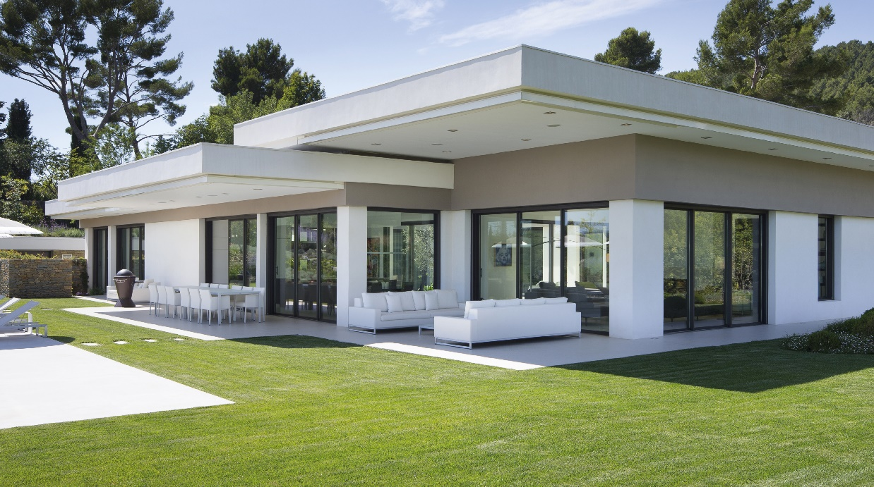
Aluminium Inline Sliding Doors
AA4110

Slide 15
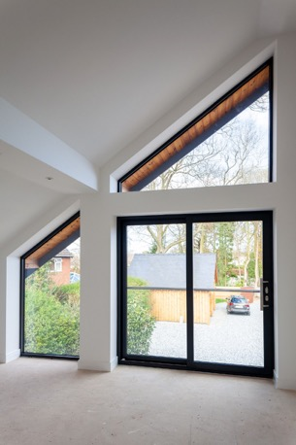
Aluminium Inline Sliding Doors
Features
Sash widths up to 1.5m wide and 2.2m high
5 point enhanced security lock
Adjustable tandem rollers to ensure sashes run smoothly
Stainless steel wheels and tracks
87mm meeting style
28mm, 32mm or 36mm glazing

Slide 16
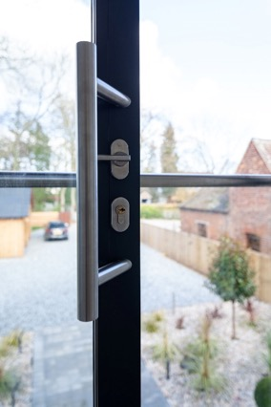
Aluminium Inline Sliding Doors
Hardware
Luxury cranked 400mm bar handle
internally and externally
Lever latch and escutcheon internally and externally
Optional:
1000mm bar handle to replace 400mm
Finger pull externally with 400mm or 1000mm
handles internally
No lever latch or escutcheon externally

Slide 17
Aluminium Inline Sliding Doors
Colours
Anthracite Grey in a luxurious Textura
finish from stock
A wide range of RAL colours and finishes
are available

Slide 18
Aluminium Inline Sliding Doors
Section through drawings

Slide 19
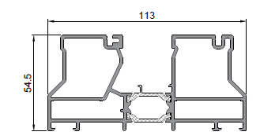
Aluminium Inline Sliding Doors
Features
Twin track
Frame depth 113mm
196mm Cill
2, 3 or 4 pane options
Triple track
Frame depth 175mm
249mm Cill
3 or 6 pane options
Optional - Flush Floor Receptor

Slide 20
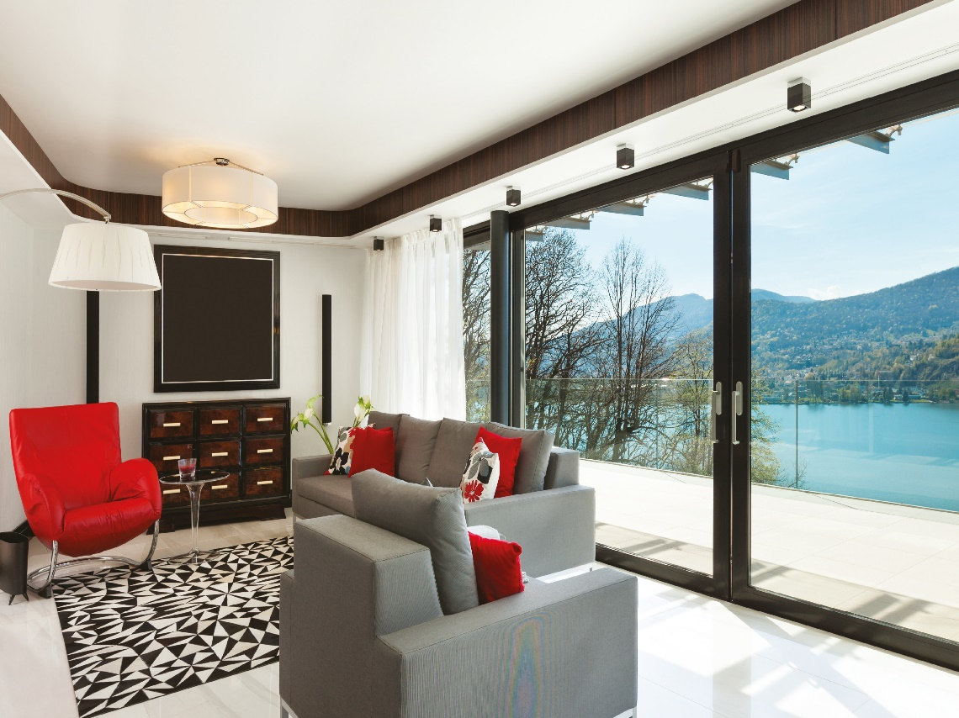
Aluminium Lift and Slide Doors
AA4110

Slide 21
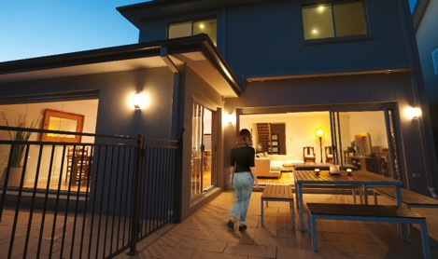
Aluminium Lift and Slide Doors
Door sashes span up to 3m wide and up to 2.6m high (subject to max sash weight 300kgs)
Stainless steel wheels and tracks
107mm meeting style
28mm, 32mm* or 36mm glazing
Cills and frame depth are the same for Inline
and Lift & Slide
*32mm triple glazing available if overall glass dimension is less than 2.4m²

Slide 22
Aluminium Lift and Slide Doors
Hardware
250mm brushed steel Lift & Slide handle to inside
Stainless steel track
Max sash weight 200kgs
Optional
Brushed steel Lift & Slide handle to outside
Finger pull to outside

Slide 23
Aluminium Lift and Slide Doors
Colour Options
Anthracite Grey in a Textura finish from stock
Wide range of RAL colours and finishes available

Slide 24
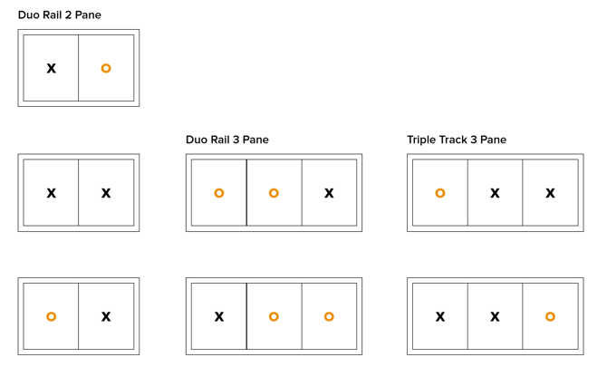
Aluminium Lift and Slide Doors
Opening Configurations

Slide 25
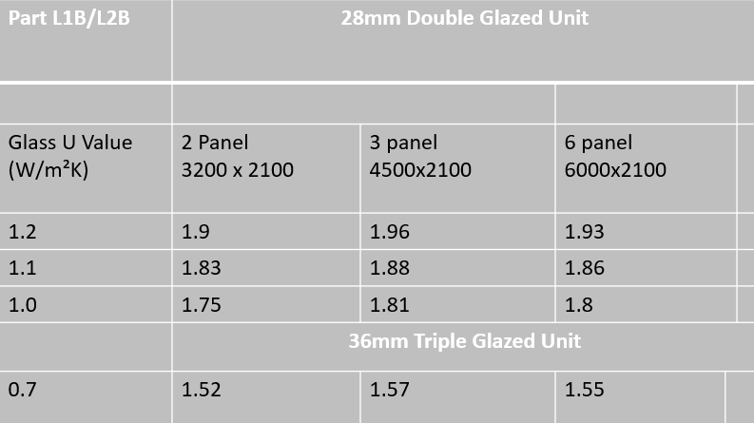
Aluminium Lift and Slide Doors
U Values

Slide 26
Aluminium Lift and Slide Doors
Features
Twin track
Frame depth 113mm
196mm Cill
2, 3 or 4 pane options
Triple track
Frame depth 175mm
249mm Cill
3 or 6 pane options
Optional – Flush Floor Receptor

Slide 27
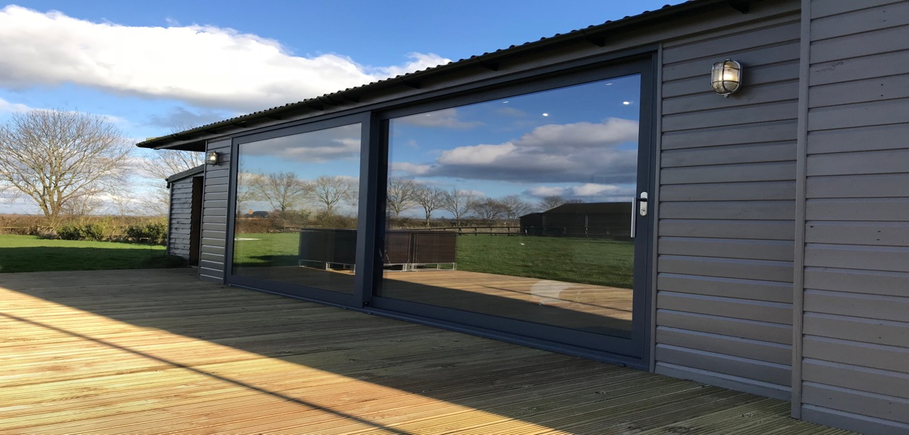
Aluminium Super-Size Sliding Doors
AA3572

Slide 28
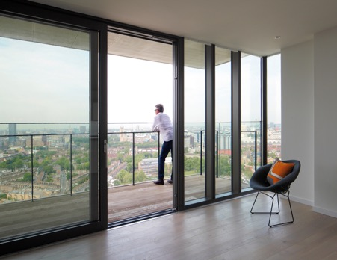
Aluminium Super-Size Sliding Doors
Features
Door sashes up to 3m x 3m
Contemporary square bead
U Value 1.3 W/m2K with 28mm double glazing
100mm meeting style
Multi-point locking
42mm Standard fully weathered threshold

Slide 29
Aluminium Super-Size Sliding Doors
Colours
Anthracite Grey in a luxurious
Textura finish from stock
A wide range of RAL colours and
finishes are available

Slide 30
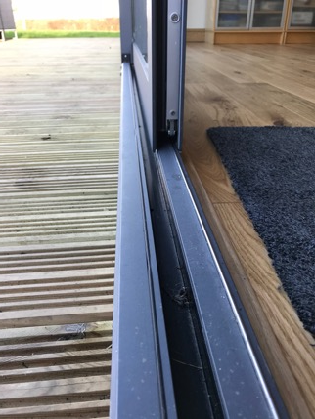
Aluminium Super-Size Sliding Doors
Dimensions
Twin Track
164mm frame depth
190mm Stub Cill / 250mm Cill
Triple Track
256mm frame depth
250mm Stub Cill / 290mm Cill

Slide 31
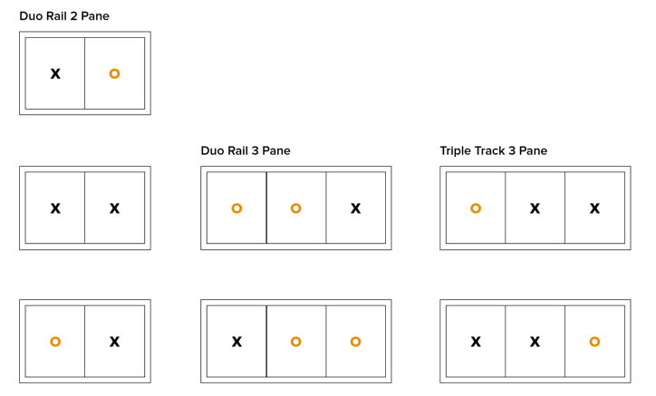
Aluminium Super-Size Sliding Doors
Opening configurations
Twin Track, 2 or 3 panes
Triple Track 3 panes

Slide 32
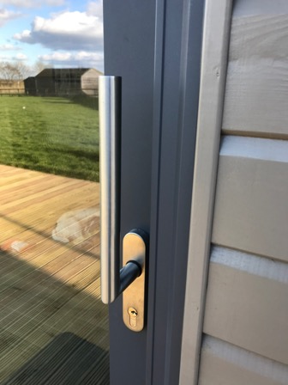
Aluminium Super-Size Sliding Doors
Hardware
Handle is rotated 180° to open the doors
Brushed Stainless Lift & Slide handle
internally and externally as standard
Optional
Lift & Slide handle internally only
Finger pull externally to replace Lift &
Slide handle

Slide 33
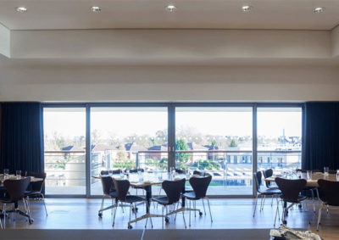
Aluminium Slim Sliding Doors
Visoglide plus

Slide 34
Aluminium Slim Sliding Doors
Features
Slim 35mm sightlines
Available as Inline Slider or Lift & Slide
U Values from 1.6 W/m2k
28mm glazing as standard with square bead
2, 3 or 4 sash options

Slide 35
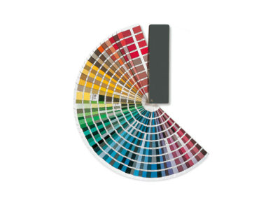
Aluminium Slim Sliding Doors
Colours and Hardware
Wide range of RAL colours and finishes
Off-set ‘D’ handle in Black, White or Silver
as standard.
Handles can be colour-matched to the
door profile if requested.

Slide 36
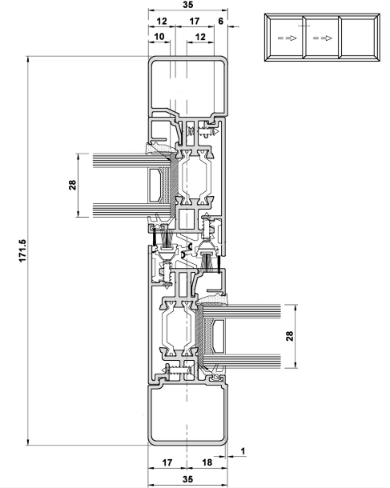
Aluminium Slim Sliding Doors
Section through drawings

Slide 37
Aluminium Slim Sliding Doors
Dimensions of Inline Sliding Doors Max sash height: 2500mm Providing sashes are within max sash weight of 200kgs, there is no maximum width. Lock will have two locking points where sash is below 1400mm. For PAS24:2012 the minimum height is 1885mm. | Dimensions of Lift & Slide Doors Max sash width: 3294mm Min sash height: 1718mm Max sash height: 2500mm Max sash weight: 300kgs

Slide 38
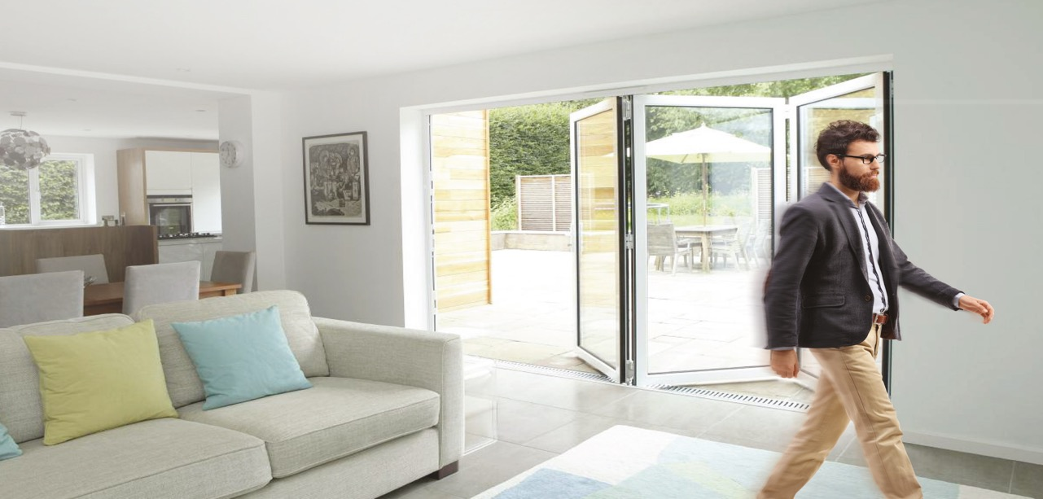
Aluminium Bifold Doors

Slide 39
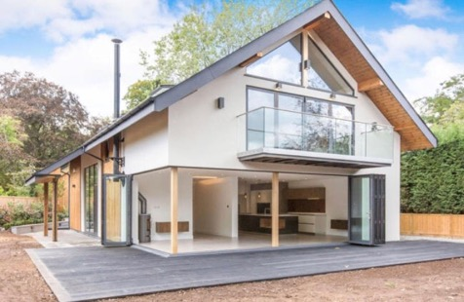
Aluminium Bifold Doors
Features
From 1 to 7 panels in various configurations
Inward or outward opening
Standard fully weathered threshold 45mm
Low threshold option 24mm
3 star diamond security rated cylinder with Kitemark
PAS24:2016 enhanced security available
28mm Square glazing bead as standard
Sits on 104mm, 159mm and 199mm cills

Slide 40
Aluminium Bifold Doors
Colour Options
Anthracite Grey in a luxurious Textura finish from stock
Wide range of RAL colours and finishes are available

Slide 41
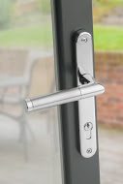
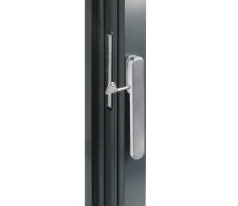
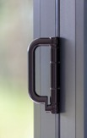
Aluminium Bifold Doors
Hardware
Master handles with design exclusive to KAT. Available in White, Grey, Black, Chrome, Gold and Brushed Steel, with a 10 year guarantee.
Locking intermediate lever handle available in White, Black, Chrome and Brushed Steel finish.
A Black ‘D’ handle
is also fitted to all Bifold Doors.

Slide 42
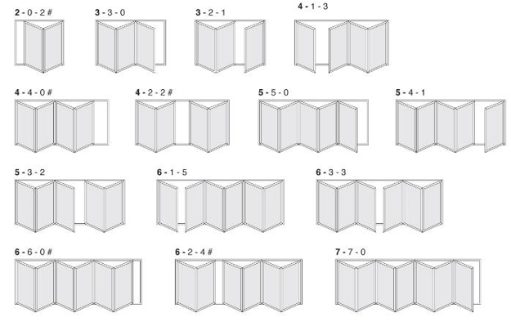
Aluminium Bifold Doors
Configuration Options
On styles marked with an #, there is no traffic door and doors can only be opened from inside the property.

Slide 43
Aluminium Bifold Doors
Size limits
Max Sash Width 1200mm
 | Maximum | Minimum
Height | 2900mm depends on width | 1800mm
Overall width | 840mm | 1400mm based on 2 panels
Panel width | 1200mm | 700mm
Weight per panel | 120 Kgs

Slide 44
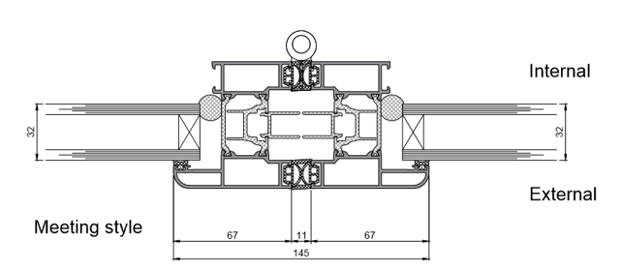
Aluminium Bifold Doors
Sightline
Glass to glass sightline is 145mm

Slide 45
Aluminium Bifold Doors
Part L1B/L2B | OPEN IN OR OPEN OUT FSD
 | Panel Variant
Glass U Value (W/m²K) | 2 Panel | 3 Panel | 4 Panel | 5 Panel | 6 Panel
1.2 | 1.54 | 1.52 | 1.51 | 1.50 | 1.50
1.1 | 1.47 | 1.44 | 1.44 | 1.43 | 1.43
1.0 | 1.40 | 1.37 | 1.36 | 1.35 | 1.35
0.9 | 1.32 | 1.29 | 1.29 | 1.28 | 1.28 | Door U Value
0.8 | 1.25 | 1.22 | 1.21 | 1.20 | 1.20
0.7 | 1.18 | 1.15 | 1.14 | 1.13 | 1.12
0.5 | 1.03 | 1.0 | 0.99 | 0.98 | 0.97
U Values

Slide 46
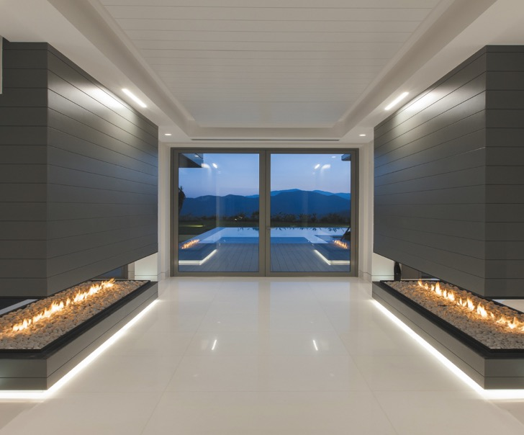
Aluminium French Doors
.

Slide 47
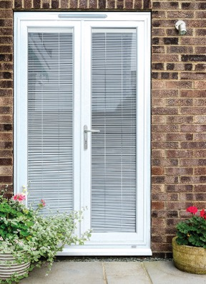
Aluminium French Doors
Features
Standard fully weathered threshold*
Frame depth 72mm front to back
3 hook multi-point lock
Square 28mm glazing bead as standard
3 star cylinder with Kitemark
Sits on 104mm, 159mm and 199mm cills*
* product in development currently
.

Slide 48
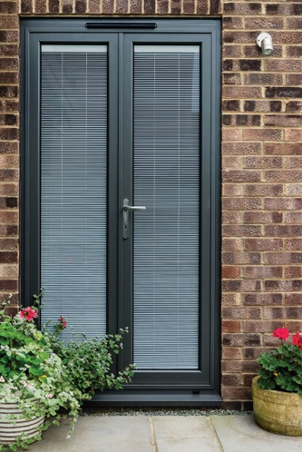
Aluminium French Doors
Optional
32mm & 44mm square bead options
24mm Low threshold option is fully weathered
PAS24:2016 enhanced security
.

Slide 49
Aluminium French Doors
Hardware
Lever handles fitted to Master and Slave door with design exclusive to KAT. *
Available in White, Grey, Black, Chrome, Gold and Brushed Steel, with a 10 year guarantee.

Slide 50
Aluminium French Doors
Colour Options
Anthracite Grey in a luxurious Textura finish from stock
Wide range of RAL colours and finishes are available

Slide 51
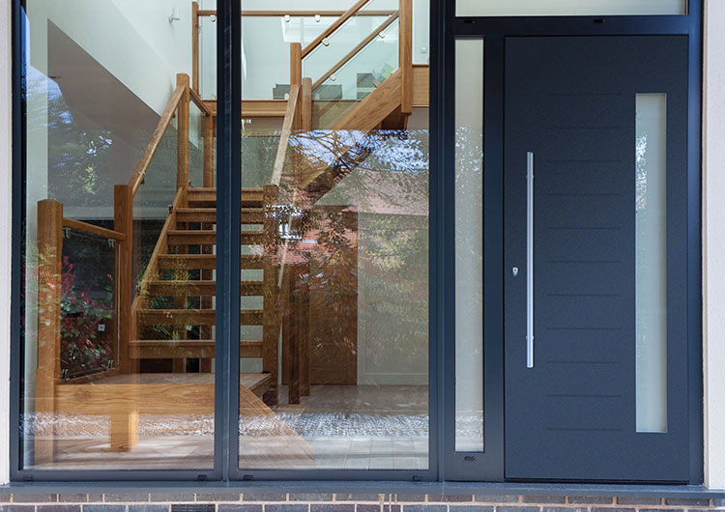
Belvedere Entrance Doors

Slide 52
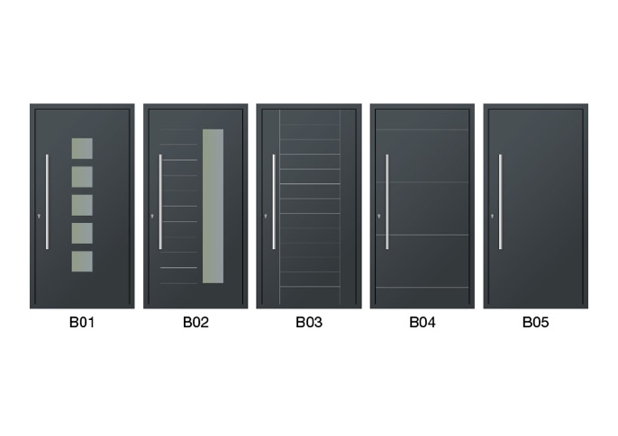
Belvedere Entrance Doors
Designs available
5 contemporary designs in Anthracite Grey Matt -from stock

Slide 53
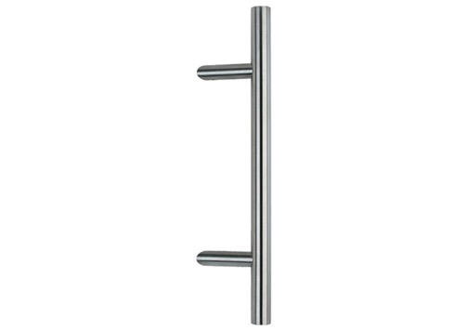
Belvedere Entrance Doors
Hardware
1000mm Cranked bar handle in Brushed Steel finish to inside and outside
Thumbturn to inside

Slide 54
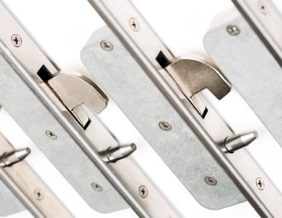
Belvedere Entrance Doors
Features
72mm door frame depth
5 point locking hook lock
3 star cylinder with Kitemark
Severe weather tested 45mm threshold
Double glazed units with satin obscured glass

Slide 55
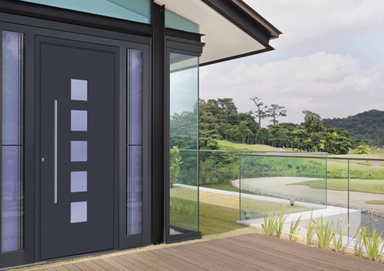
Belvedere Entrance Doors
Dimensions
Max outerframe size 986mm wide by 2,184mm high with standard threshold
1,054mm wide x 2,218mm high with 34mm add-on option
Side lights and top lights available

Slide 56
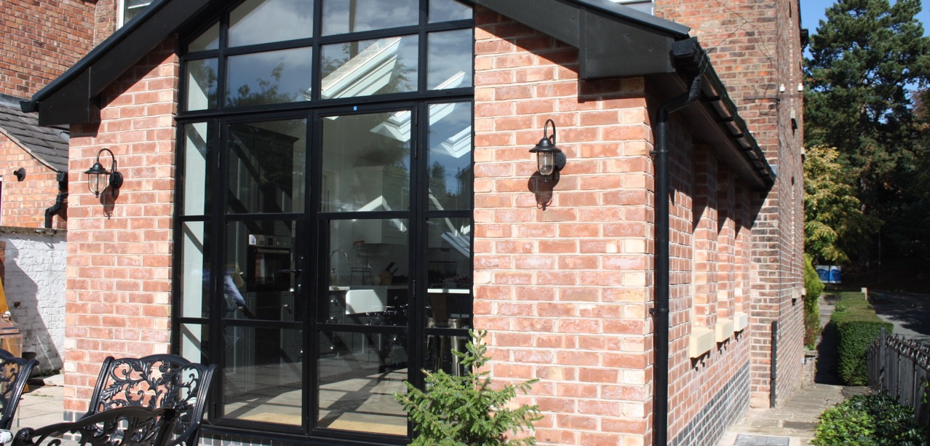
Art Deco Doors

Slide 57
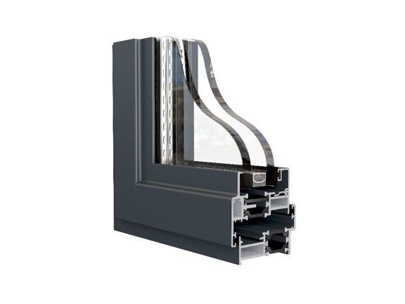
Art Deco Doors
Features
59mm slim frame
Available as single doors or double doors
47mm frame depth front to back
U-Value of 1.5 with a double glazed unit
Weather test results:
Air 600pa Water 600pa Wind 2400pa

Slide 58
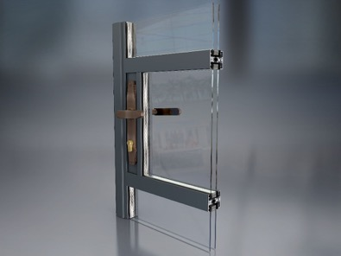
Art Deco Doors
Hardware
Handles are available in a wide range of colours and finishes, including:
Anodised shades of gold, bronze, silver, grey and black or textured anthracite grey.

Slide 59
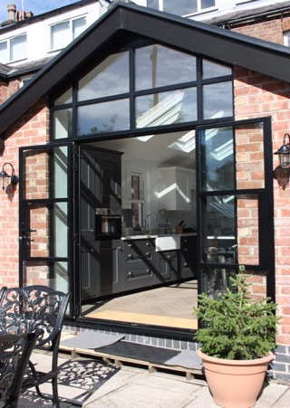
Art Deco Doors
Security
On double doors, one pair of handles is fitted to the master door sash, with a face mounted shoot bolt to secure the slave door.
Multi-point locking
3 Star security cylinder

Slide 60
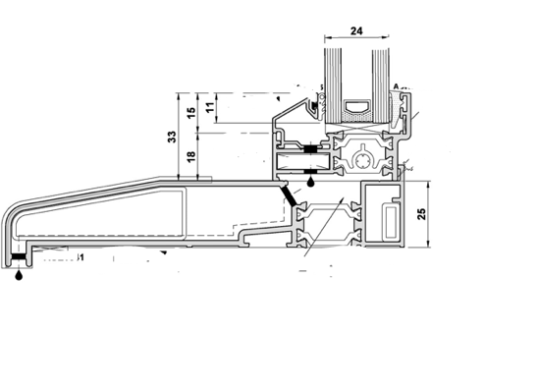
Art Deco Doors
Threshold and Cills
33mm Standard fully weathered threshold
Cills available in 85mm, 135mm, 150mm, 190mm, 225mm or 300mm

Slide 61
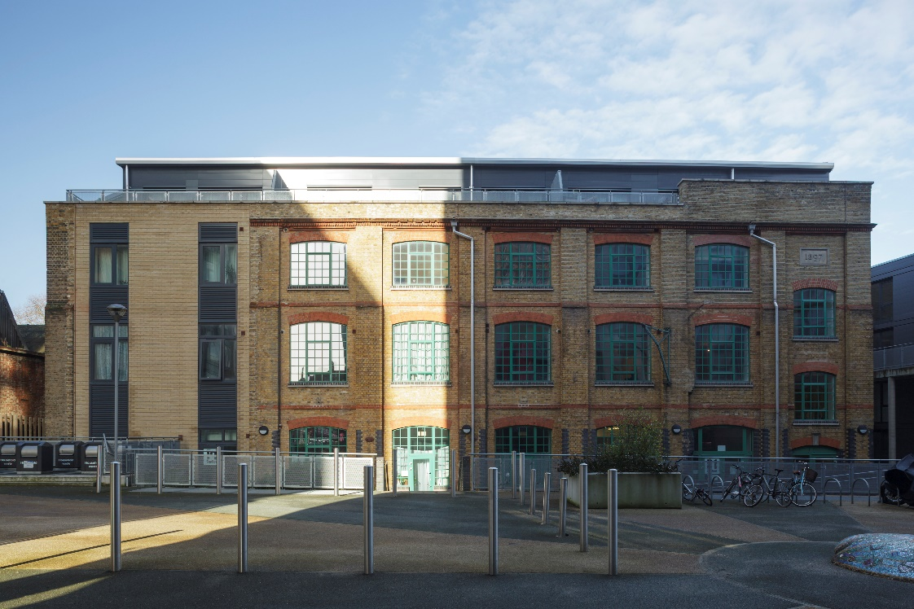
Art Deco Windows

Slide 62
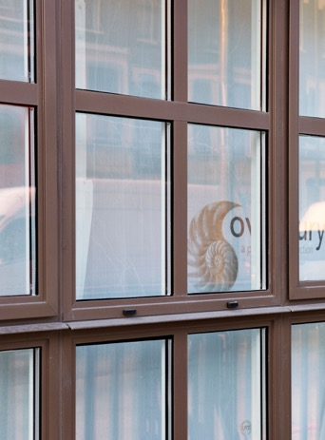
Art Deco Windows
Features
Slim 59mm sightline
U-Value down to W/m2K 1.5 with double glazed unit
47mm slim frame depth

Slide 63
Art Deco Windows
Hardware
A full suite of handle options is available to match KAT’s Art Deco doors, with Victorian and Art Deco styles including:
‘Monkey Tail’ or ‘Bulb End’
Handles available in any RAL colour, or anodised:
gold, bronze, silver, grey and black.

Slide 64
Art Deco Windows
Options
PAS 24 Security
Windows can be side hung, top hung, fixed
or tilt and turn
Arched head and circular shaped windows available
Can be internally beaded if preferred

Slide 65
KAT Aluminium Doors and Windows
Skip To:
Windows
Sliding Doors
Bifolding Doors
Entrance Doors
Art Deco Doors and Windows

