Slide 1
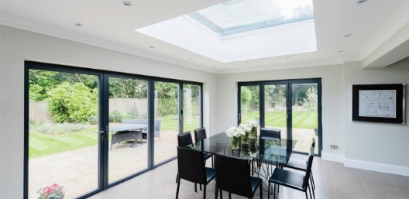
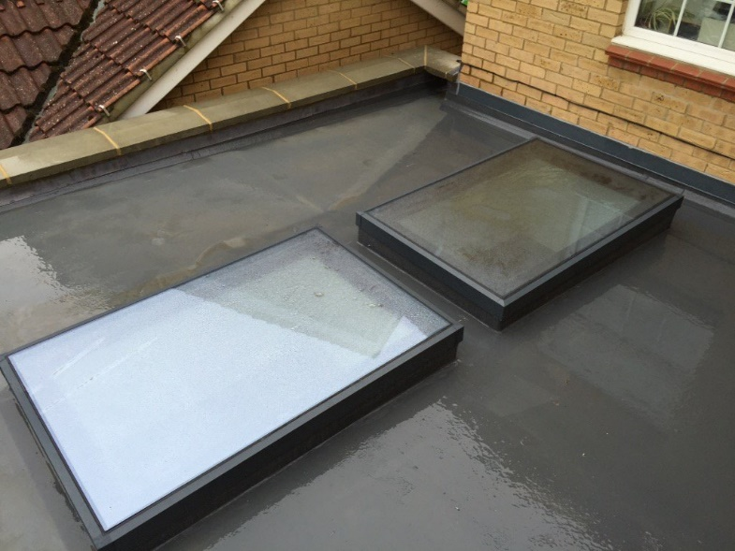
KAT Flat Roof Light

Slide 2
Aluminium – Flat Roof Light
Features
Made to bespoke sizes
Excellent thermal properties to keep your home warm
Easy to install
White, Anthracite Grey or Black
28mm clear toughened double glazing
Up to 1200mm x 2500mm or 1400mm x 2000mm
10 Year Guarantee
Options
Solar control glass with a neutral tint
Wide range of RAL colours available

Slide 3
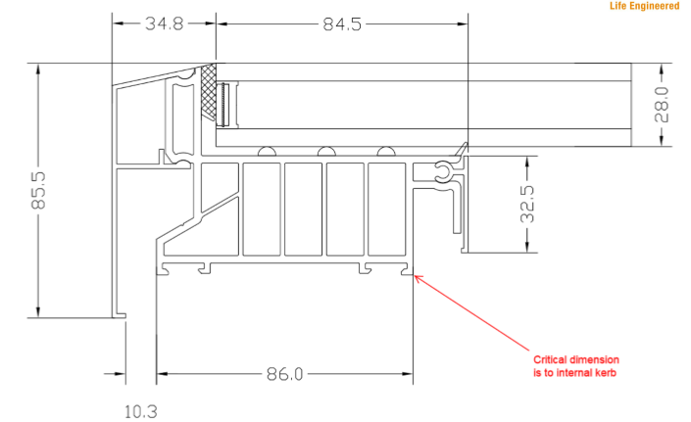
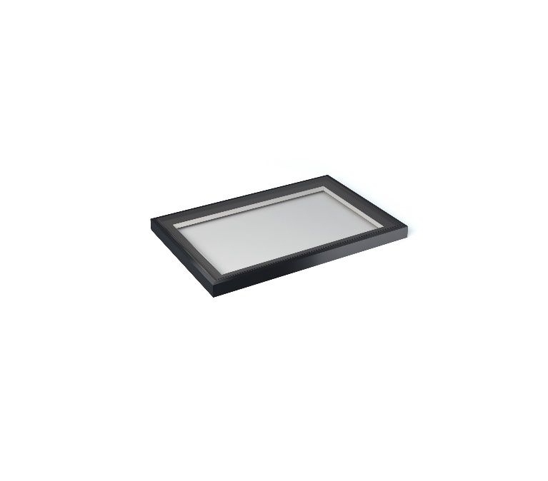
Aluminium – Flat Roof Light
Section detail
White, Anthracite Grey or Black frame colour
Flat Rooflight measurements
The roof light is suitable for flat roofs and must be installed with a minimum of 5⁰ rake to allow the water to run off.

Slide 4
Aluminium – Flat Roof Light
Size limitations
Up to 1200mm x 2500mm or
Up to 1400mm x 2000mm

Slide 5
Aluminium – Flat Roof Light
Summary
Narrow internal sightlines for a perfect finish
Excellent thermal properties
Up to 1200mm x 2500mm or 1400mm x 2000mm
28mm clear toughened double
Easy to install
White, Anthracite Grey or Black
Suitable for flat roofs
Bespoke sizes

Slide 6
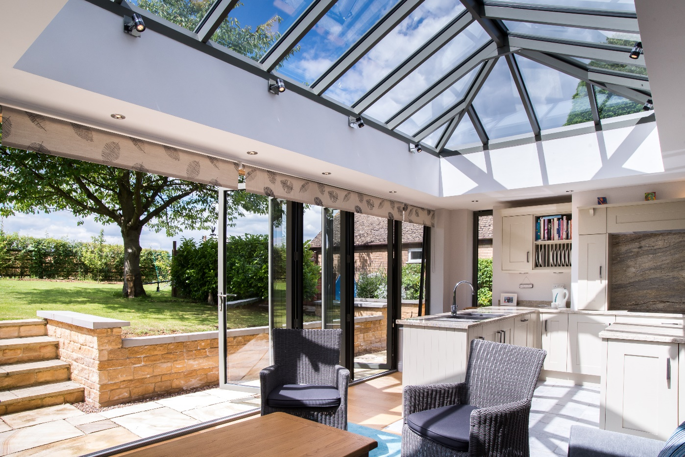
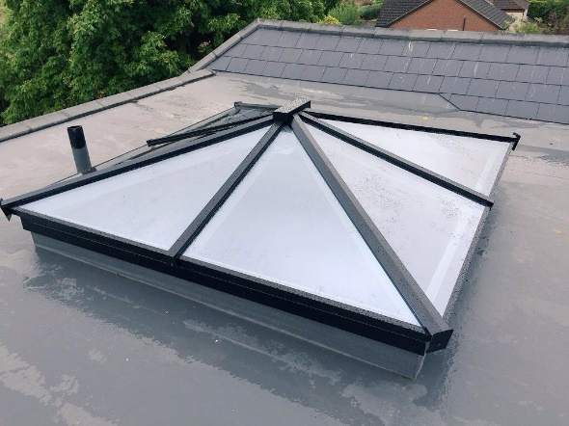
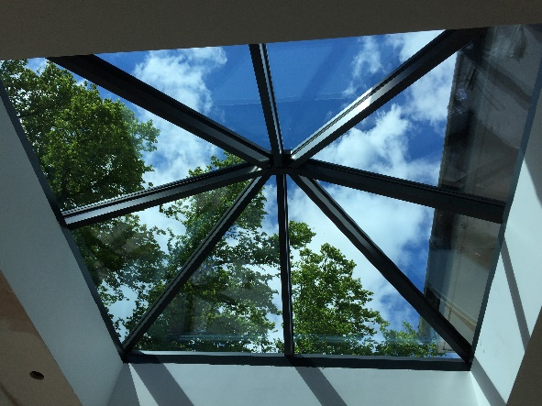
KAT Lantern Roof

Slide 7
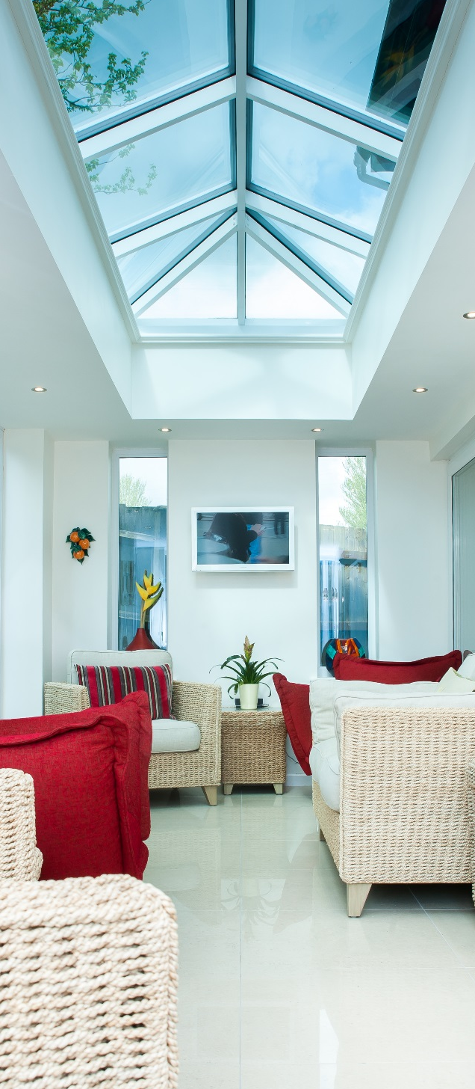
Aluminium –Lantern Roof
Features
The slimmest Lantern Roof in Europe
No clunky bars and supports
No obtrusive profiles dominating the glazing
40mm aluminium rafters
Warm in winter cool in summer
Excellent thermal properties, 1.5 full roof U-value
Toughened, self cleaning, low glazing with warm edge spacer
Excellent load capability – 1.4 KN/m sq.
Up to 5 metres wide and almost no length constraint

Slide 8
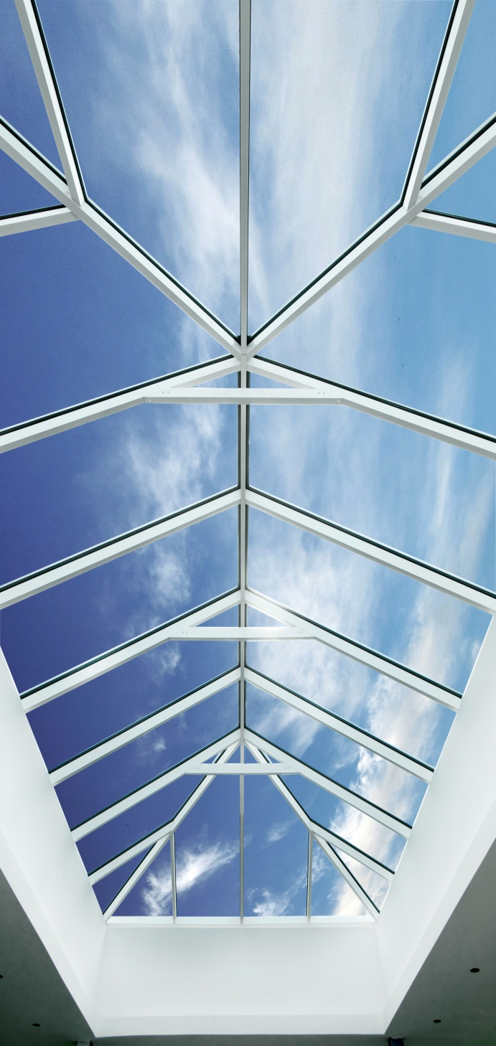
Aluminium – Lantern Roof
Colour options
External frame
White, Anthracite Grey & Black
Internal frame
White, Anthracite Grey & Black

Slide 9
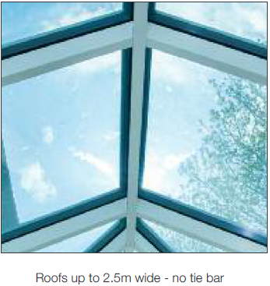
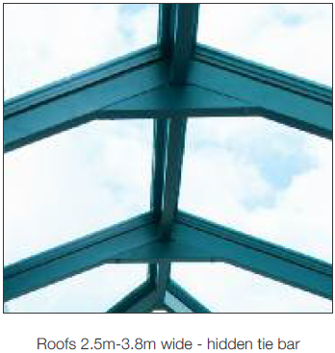
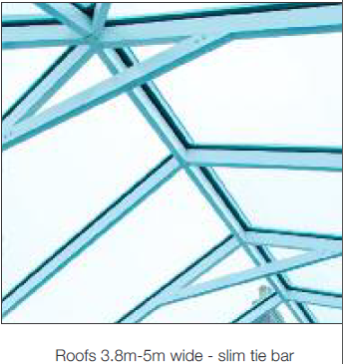
Aluminium –Lantern Roof
Size limitations
Maximum width 5m
No maximum length constraint

Slide 10
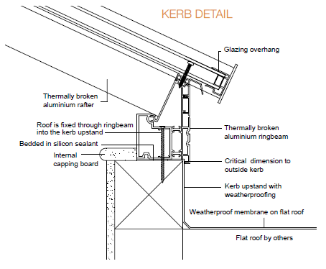
Aluminium – Lantern Roof
Kerb Detail

Slide 11
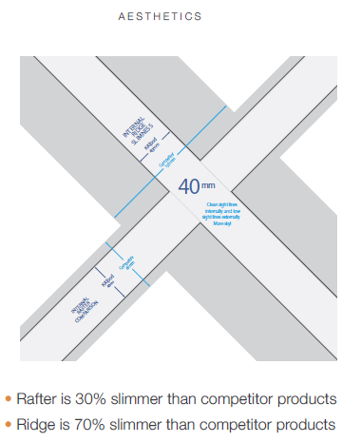
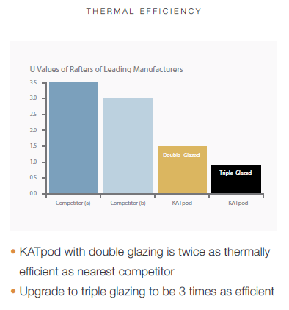
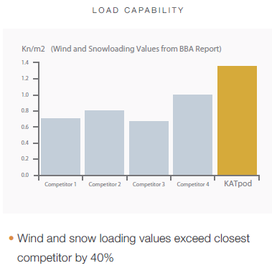
Aluminium – Lantern Roof
A little technical detail

Slide 12
Aluminium – Lantern Roof
Summary
The slimmest Lantern Roof in Europe
No clunky bars and supports
No obtrusive profiles dominating the glazing
40mm aluminium rafters
Warm in winter cool in summer
Excellent thermal properties, 1.5 full roof U-value
Toughened, self cleaning, low glazing with warm edge spacer
Excellent load capability – 1.4 KN/m sq.
Up to 5 meters wide and almost no length constraint

Slide 13
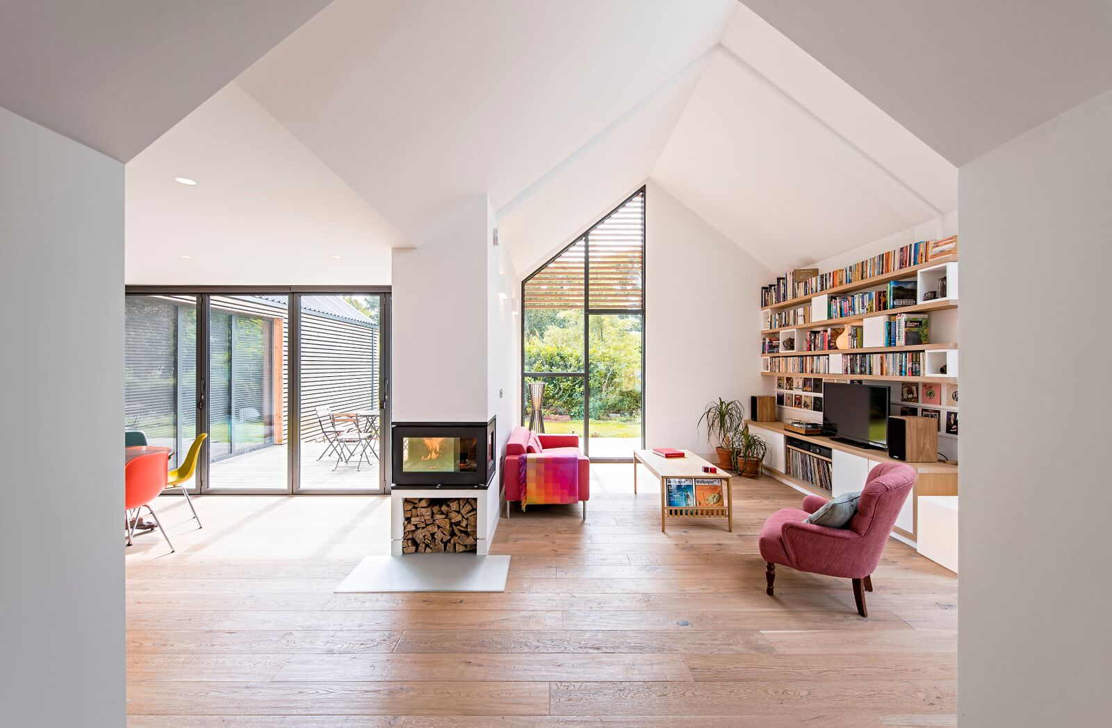
CONTACT KAT

