Slide 2
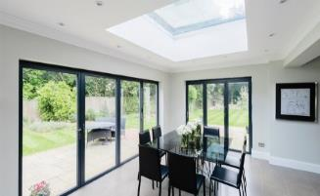
Aluminium – KATlite Flat Roof Light
Features
Narrow internal sightlines for a perfect finish
Excellent thermal properties
Up to 1.5m wide and 2.5m high
32mm clear double glazing - laminated internal pane, toughened external pane
Easy to install
Anthracite Grey
Suitable for flat roofs
Bespoke sizes

Slide 3
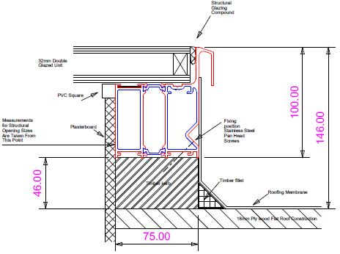
Aluminium – KATlite Flat Roof Light
Section detail
Anthracite Grey frame colour
RAL 7016

Slide 4
Aluminium – KATlite Flat Roof Light
Size limitations
Up to 2.5m wide
Up to 1.5m wide

Slide 5
Aluminium – KATlite Flat Roof Light
Summary
Narrow internal sightlines for a perfect finish
Excellent thermal properties
Up to 1.5m wide and 2.5m high
32mm clear double glazing - laminated internal pane, toughened external pane
Easy to install
Anthracite Grey
Suitable for flat roofs
Bespoke sizes

