Slide 1
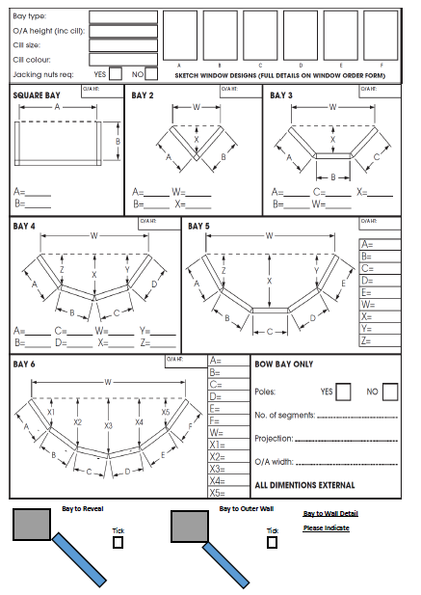
Order Form
September 2016
Box Sash Windows – Bay Window
KAT FAX: 01625 439777 www.katuk.co.uk V1.Sept16.PB
KAT FA

